Slide 1
Chapter 2: Levels of Measurement and Their Importance

Slide 2
Introduction
Need to know the basics of numbers used to score a test.
Levels of measurement.
Higher the levels of measurement, more powerful the types of analysis used.
Notes:
Need to know the basics of numbers used to score a test:
Measuring things basically means slapping a score on them, so, it is important to understand the nuts-and-bolts of the numbers that are used to score tests and how they come to be.
Levels of measurement:
It refers to the way that numbers are assigned to represent variables.
Low levels of measurement provide very little information about how people differ from each other on some variable whereas high levels of measurement tell a lot about how people differ from each other on some variable.
Higher the levels of measurement, more powerful the types of analysis used:
For instance, in one study, researchers used trusted and field-tested assessment tools to examine how self-determination and self-concept have an effect on academic achievement for adolescents with learning disabilities.
They found significant relationships among self-determination, self-concept, and academic achievement, with self-determination being a useful predictor of academic achievement for these students.
As these variables were quantified using a high level of measurement, correlation coefficients and multiple regression could be used.

Slide 3
First Things First (1 of 2)
Variable: takes more than one value.
Representation of variables.
Measurement: assignment of labels to a variable.
Controversy over what some levels mean.
Notes:
Variable:
It is anything that can take on more than one value.
Examples: a score on the SAT can take on more than one value, a person’s age category of color of a person’s hair, favorite flavor of ice cream, etc.
Representation of variables: Variables can be represented by quantities or by different categories (which is what qualitative means).
Measurement:
It is the assignment of labels to a variable or an outcome.
For example: by applying the label “blue” to a particular outcome, that outcome is measured.
The label can be precise or sometimes, less precise too.
Controversy over what some levels mean:
There is a great deal of discussion and controversy over what some levels mean.
These are interesting and provocative options that represent different theoretical constructs as well as different levels of measurement.

Slide 4
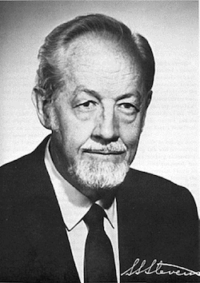
First Things First (2 of 2)
Questions put forth by S.S. Stevens about variables.
Way of measurement determines the level of measurement.
Notes:
Questions put forth by S.S. Stevens about variables:
In 1946, S. S. Stevens, a famous experimental psychologist, wondered how different types of variables are measured and if the level of precision of measurement needs to be classified to be more easily understood.
He also wondered if a system (what he called a set of rules) could be developed so the outcomes that result from the measurement process can be classified based on the characteristics of the variable itself, rather than the actual value or label of the variable.
Way of measurement determines the level of measurement:
Variables can be measured in different ways and the way it is measured determines the level of measurement being used.
For example, the height of any two individuals can be measured in different ways.
If Bruce is taller than Neil, then we know one person is less tall than another and the people involved are sorted using the ranks.
But when we chose to measure this variable in a way that differentiates people by a certain quantity of inches, that is much more precise and much more informative.
Thus, we have different interpretations of the same variable because two different levels of measurement were used.

Slide 5
The Four Horsemen (Or Levels) of Measurement (1 of 12)
Level of measurement.
  The amount of information provided by the outcome measure.
Notes:
The Four Horsemen (Or Levels) of Measurement
Level of measurement: the amount of information provided by the outcome measure.

Slide 6
The Four Horsemen (Or Levels) of Measurement (2 of 12)
The Nominal Level of Measurement
Numbers are used to identify different categories.
Reason to call it “nominal” level.
Limitation: not much to learn about a variable.
Notes:
2.2. Explain the four levels of measurement.
The Nominal Level of Measurement
Nominal level of measurement:
It describes a measurement system where numbers are used to identify different categories, but not used as quantities.
The labels used are qualitative in nature and people (or objects) can be placed in one and only one category.
Therefore the labels are mutually exclusive.
Reason to call it “nominal” level:
The word nomin in Latin means name.
The level is called nominal level of measurement because the only distinction that can be made is that variables differ in the category in which they are placed.
Variables are “measured” only by the nature of the group to which they belong.
Limitation of nominal level of measurement:
Using the nominal level of measurement there is not much one can learn about a variable except that to which category it belongs.
This is the biggest limitation with the level of measurement.
To gather information, one has to dig more and define the variable in a more precise way.

Slide 7
The Four Horsemen (Or Levels) of Measurement (3 of 12)
The Nominal Level of Measurement
In science, variable is measured at nominal level.
Discussions about the measurement levels.
Notes:
In science, variable is measured at nominal level:
While considering the limitation of using nominal levels of measurement in social science research, it turns out to be a major weakness.
But in science, two groups are compared and differences are determined.
Example: comparing an experimental group that received a new drug with a control group that did not on some health outcome (like blood pressure).
In this case, the variable from which we create the two groups is measured at the nominal level.
Sometimes, variables should only be measured at the nominal level because that makes the most sense.
Discussions about the measurement levels:
There is much discussion going on about measurement levels and their utility, starting with the definition of variables and how those variables are measured.
Some people doubt if nominal level of measurement is a level at all and believe that it is only a qualitative description of some outcome.

Slide 8
The Four Horsemen (Or Levels) of Measurement (4 of 12)
Important features of the nominal level:
  Mutually exclusive categories.
  Measures are always qualitative.
Notes:
2.2. Explain the four levels of measurement.
The Nominal Level of Measurement
Important features of the nominal level:
Mutually exclusive categories:
The categories in which measures can be placed on the nominal scale are always mutually exclusive.
For example, a preschooler cannot be in the red preschool room and the blue preschool room at the same time.
Measures are always qualitative:
Nominal-level measures are always qualitative and the values are categories and not quantities.
When a preschooler may belong to the red or blue room and the room assignment says nothing more than which room the preschooler belongs to.

Slide 9
The Four Horsemen (Or Levels) of Measurement (5 of 12)
The Ordinal Level of Measurement
Describes how variables can be ordered along a continuum.
Includes only one criteria for a measure.
Use of ranking in a study on common childhood fears.
Notes:
2.2. Explain the four levels of measurement.
The Ordinal Level of Measurement
Ordinal level of measurement:
It describes how variables can be ordered along some type of continuum.
Like the nominal scale, the outcomes of the measurement are placed in categories but the categories have an order or rank to them.
Examples: stronger and weaker, taller and shorter, etc.
Includes only one criteria for a measure:
There is the one and only necessary criterion for a measure to be at the ordinal level of measurement.
For example, consider Max is a better reader than Aya.
Here, we cannot tell anything about how good a reader either Max or Aya is, because ordinal levels of measurement do not include this information.
In the ordinal level of measurement, one can learn if a person scores higher than (or lower than) another person but cannot know how good a reader a person is.
Therefore by using the ordinal level of measurement we cannot know how great the students of the class are in reading.
Use of ranking in a study on common childhood fears:
The real world example of ordinal-level measurement is a study by Kathe Burkhardt and her colleagues that appeared in the journal Behavior Change.
The team examined common childhood fears in 9- to 13-year-old South African children, and assessed fears by having children rank them.
The study revealed that the children’s rankings of fears differed from rankings derived using a scale that attached an actual value to the fear.

Slide 10
The Four Horsemen (Or Levels) of Measurement (6 of 12)
The Interval Level of Measurement
A jump in the level of information.
Assigning a value to an outcome.
Quantities are precise.
Notes:
Interval level of measurement:
It gives us a nice jump in the amount of information.
It is also the most popular approach used in the real world.
Assigning a value to an outcome:
The interval level of measurement allows the assignment of values (that is based on the underlying continuum that has equal intervals) to the outcome.
The underlying continuum allows us to make very definite statements about someone’s position along that continuum and their position relative to another person’s position and statements about such things as differences.
Quantities are precise:
In interval level of measurement, scores tell us that each score is different from each other in some way (like the nominal-level does).
The scores represent more and less of some quantity (like the ordinal-level does).
But the quantities are precise enough to show that the distance between any two adjacent scores on the scale is equal.
Consider the example of a Celsius thermometer.
The difference between 48 degrees and 47 degrees is one degree of heat and so is the difference between 34 degrees and 33 degrees.
Therefore, the mathematical difference between any two scores that are side-by-side along the scale is the same as the quantitative difference between units of the variable.

Slide 11
The Four Horsemen (Or Levels) of Measurement (7 of 12)
The Interval Level of Measurement
Examining the architectural origins of the word “interval.”
Need for careful interpretation of scores.
Notes:
Examining the architectural origins of the word “interval”:
Interval, or inter val, means between walls.
It describes the top of towers and such on old castles.
Need for careful interpretation of scores:
Interval level of measurement offers more information than nominal and ordinal levels.
But one must be very careful while interpreting scores obtained through the interval level of measurement.
For example, when a person scores 50% higher in a history test, it does not imply that the score represents 50% more knowledge but only means that 50% more of the questions were answered correctly.
When more questions are answered, that student can be considered the better one in history.
However, one must not carry it too far and overgeneralize from a test score to an entire area of knowledge or a construct such as intelligence.

Slide 12
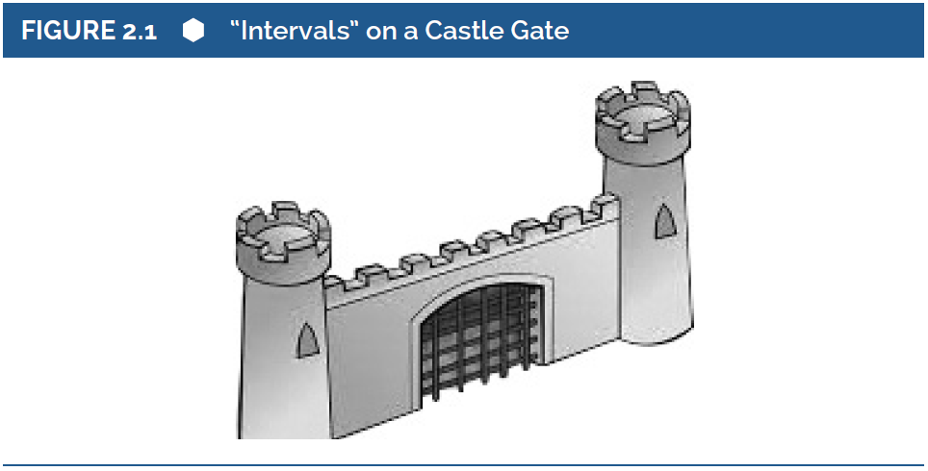
Castle Example
Notes:
2.2. Explain the four levels of measurement.
Figure 2.1: “Intervals” on a Castle Gate.
The Interval Level of Measurement
In the above figure, there are little stone protective barriers at the top of the towers.
While a well-built castle needs protection, there is also the need for openings to shoot arrows at the bad guys.
And the best design should have equal spacing between those barriers all the way around.
This is because the arrows may be coming from anywhere.

Slide 13
The Four Horsemen (Or Levels) of Measurement (9 of 12)
The Interval Level of Measurement
Advantage: provides a lot of information.
A study on tourists’ perceived value and destination loyalty.
Notes:
Advantage of interval level of measurement:
Besides increased precision, the big advantage of the interval level of measurement is information.
There is more information available when one knows what advantage of the interval level of measurement.
A study on tourists’ perceived value and destination loyalty:
Shintaro Saro at Montclair State University and colleagues were interested in tourists who visit sports venues.
They wanted to examine the relationship between the perceived value of the experience and loyalty of the tourists.
With the interval level of measurement, they were able to use advanced statistical analyses involving correlations.
The results showed that for experienced travelers, for the emotional response related to the experience was the best predictor of planning to return, but for novice travelers, it was perceptions of quality that was most important.

Slide 14
The Four Horsemen (Or Levels) of Measurement (10 of 12)
The Ratio Level of Measurement
The most informative but rare.
Includes an absolute zero.
Using the scale with nonphysical attributes.
Notes:
The most informative but rare:
The ratio level of measurement is by far the most informative.
However, it is the least likely to be seen in the social or behavioral sciences.
Includes an absolute zero:
It is least likely to be seen in social or behavioral sciences because the ratio level of measurement includes a very important assumption - an absolute zero.
The absolute zero implies the absence of the trait or characteristic being measured.
Physical measurements such as amount of rainfall, weight, and height fall under the ratio level of measurement.
Using the scale with nonphysical attributes:
While it is possible to get a score of zero on a reading comprehension test, it does not that imply that the person cannot read at all.
It means only that on this test, the student scored very low.

Slide 15
The Four Horsemen (Or Levels) of Measurement (11 of 12)
The Ratio Level of Measurement
Challenge in behavioral or social sciences.
Not an issue with physical and biological sciences.
Finger tapping as a measure of responsiveness.
Notes:
Challenge in behavioral or social sciences:
One may wonder if there is any trait or characteristic in the behavioral or social sciences that an individual can have a complete absence of.
If there is none, then a ratio level of measurement is impossible.
It is for this reason, that often the interval and ratio levels are combined into one, when this level of measurement is taught.
Not an issue with physical and biological sciences:
Ratio level of measurement does not pose a similar challenge in the physical and biological sciences.
For example, consider temperature as measured on the Kelvin scale (starts at 0 and goes up but a negative value is not a possible score.
In the Celsius or Fahrenheit scoring systems for temperature, there can be negative scores on the scales (like -20 degrees Fahrenheit in the North pole).
Researchers can choose to measure the variable of heat at the interval-level, as with the Fahrenheit system, or choose to measure it at the ratio-level.
Finger tapping as a measure of responsiveness: Like the Kelvin scale, it is entirely possible to have no finger taps (the score of 0).

Slide 16
The Four Horsemen (Or Levels) of Measurement (12 of 12)
The Ratio Level of Measurement
Proportions and fractions have meaning.
Choosing a scale of measurement.
Notes:
Proportions and fractions have meaning:
This level of measurement is called ratio level because proportions and fractions have meaning.
When one person gets a tapping score of 120 and another get 60, it can be said that one person has tapped twice as often as the other and this is reasonable.
However, if it is 30 degrees Fahrenheit today and it was 15 degrees yesterday, we don’t say it is twice as hot today.
This is because scores on the Fahrenheit scale go below zero, and one is not allowed mathematically to make ratio comparisons like that.
Choosing a scale of measurement:
Social and behavioral scientists rarely see a ratio-level scale in the journal articles that are reviewed or read.
The scale of measurement simply depends on how the variable is being defined and measured.

Slide 17
A Summary: How Levels of Measurement Differ (1 of 2)
More precise level of measurement and more information.
Questions to be addressed based on measuring variable.
Notes:
More precise level of measurement and more information: The study of the four different levels of measurement shows that a more precise level of measurement has all the characteristics of an earlier level and provides more information as well.
Questions to be addressed based on measuring variable:
Are you measuring most of the available information?
Can you assign a name to the variable being measured?
Can you assign an order to the variable being measured?
Can you assign an underlying quantitative scale to the variable being measured?

Slide 18
A Summary: How Levels of Measurement Differ (2 of 2)
Level of Measurement | How Much Information about the Variable Do You Get? | Can You Assign Names to the Different Scores or Outcomes? | Can You Assign an Order to the Different Scores or Outcomes? | Can You Assign an Underlying Quantitative Scale to the Different Scores or Outcomes? | Can You Assign an Absolute Zero to the Scale You are Using?
Ratio | A Great Amount | ☺ | ☺ | ☺ | ☺
Interval | A Good Amount | ☺ | ☺ | ☺ | L
Ordinal | Some | ☺ | ☺ | L | L
Nominal | A Little | ☺ | L | L | L
Notes:
2.3. Compare and contrast the four levels of measurement.
Table 2.1: A Summary of Levels of Measurement and the Characteristics That Define Them.

Slide 19
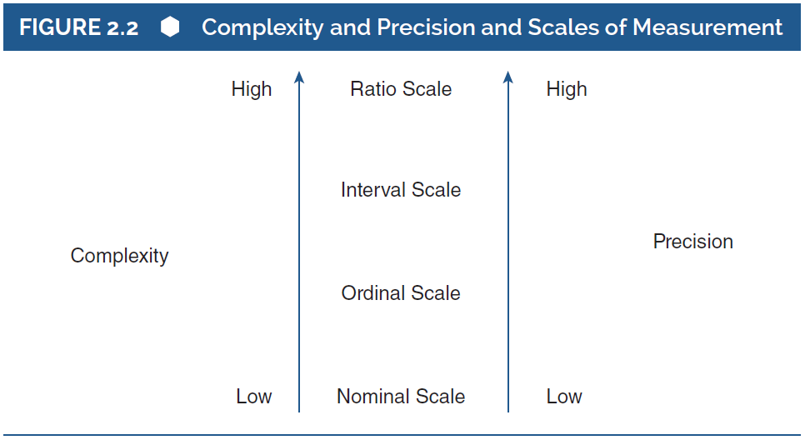
Complexity and Precision
Notes:
2.4. Give examples of how researchers choose to measure variables using different levels of measurement.
Figure 2.2: Complexity and Precision and Scales of Measurement.

